Slide 1

HEAP SORT VISUALIZATION – MIN & MAX HEAP
Group1:- Himanshu Bharati, Jaival Patel, Shalini S
DSA Project - Term_1(Qt1)
Jio Institute, PGP AI-DS Co ‘26

Slide 2
PROJECT SYNOPSIS
HEAP SORT VISUALIZATION
This project presents an interactive and educational Heap Sort Visualizer built using Python and Streamlit. The tool focuses exclusively on two variants of heap sort—Min Heap and Max Heap—offering a hands-on way to observe the internal workings of each algorithm. Users can input their own data or generate random arrays (up to 400 elements) and control the speed of the sorting process with a real-time visualization of both the bar graph representation and the binary heap tree. The visualization highlights element swaps dynamically, enabling clear understanding of the sorting mechanics.
Beyond visual appeal, the tool provides operational insights by tracking the number of comparisons and swaps, enhancing its use as a learning aid for algorithm analysis. A binary tree is rendered in parallel with the sort, and dynamically updates to reflect the current state of the heap, with swapped nodes colored distinctly. This dual-mode visualization—graphical and structural—makes the sorting process transparent and intuitive for learners and instructors alike.

Slide 3
TECH STACK AND CONCEPTS
HEAP SORT VISUALIZATION
🧰 Tech Stack
Python – Core programming language used for logic and implementation
Streamlit – Framework used to create the interactive web-based UI
Matplotlib – Used for plotting the real-time sorting bar charts
NetworkX – Used to dynamically generate and visualize the heap tree as a binary tree
NumPy – For efficient numerical operations and array handling
📘 Concepts Used
Heap Data Structure – Implementation and visualization of both Min Heap and Max Heap
Heap Sort Algorithm – Step-by-step generator-based execution of the sorting process
Binary Tree Representation – Structural layout of the heap using directed graphs
Sorting Operation Tracking – Real-time counting and display of swaps and comparisons
Dynamic UI Interaction – Speed control, input type handling, and visual updates via Streamlit widgets

Slide 4
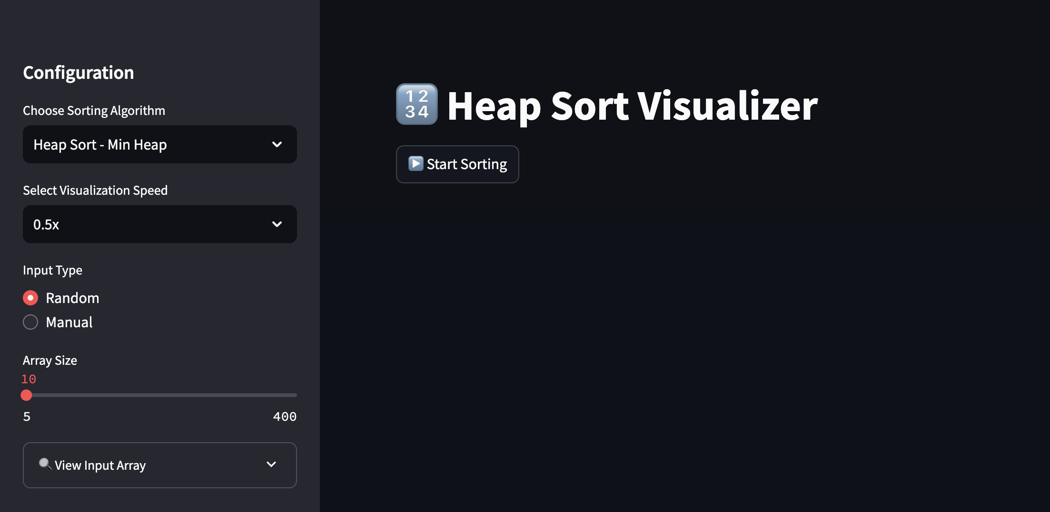
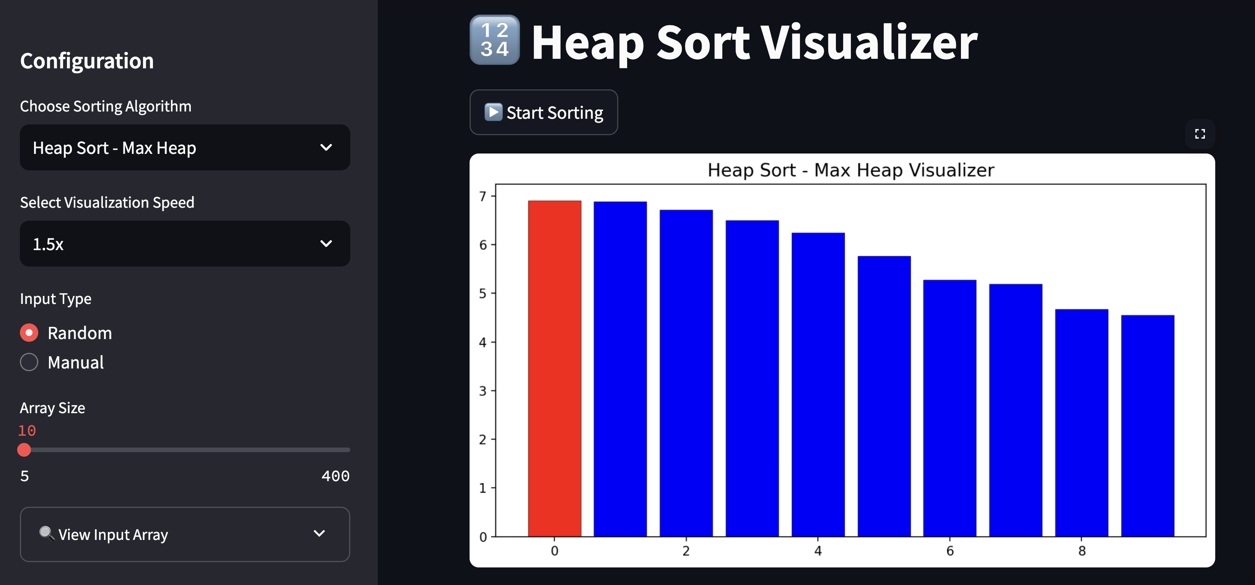
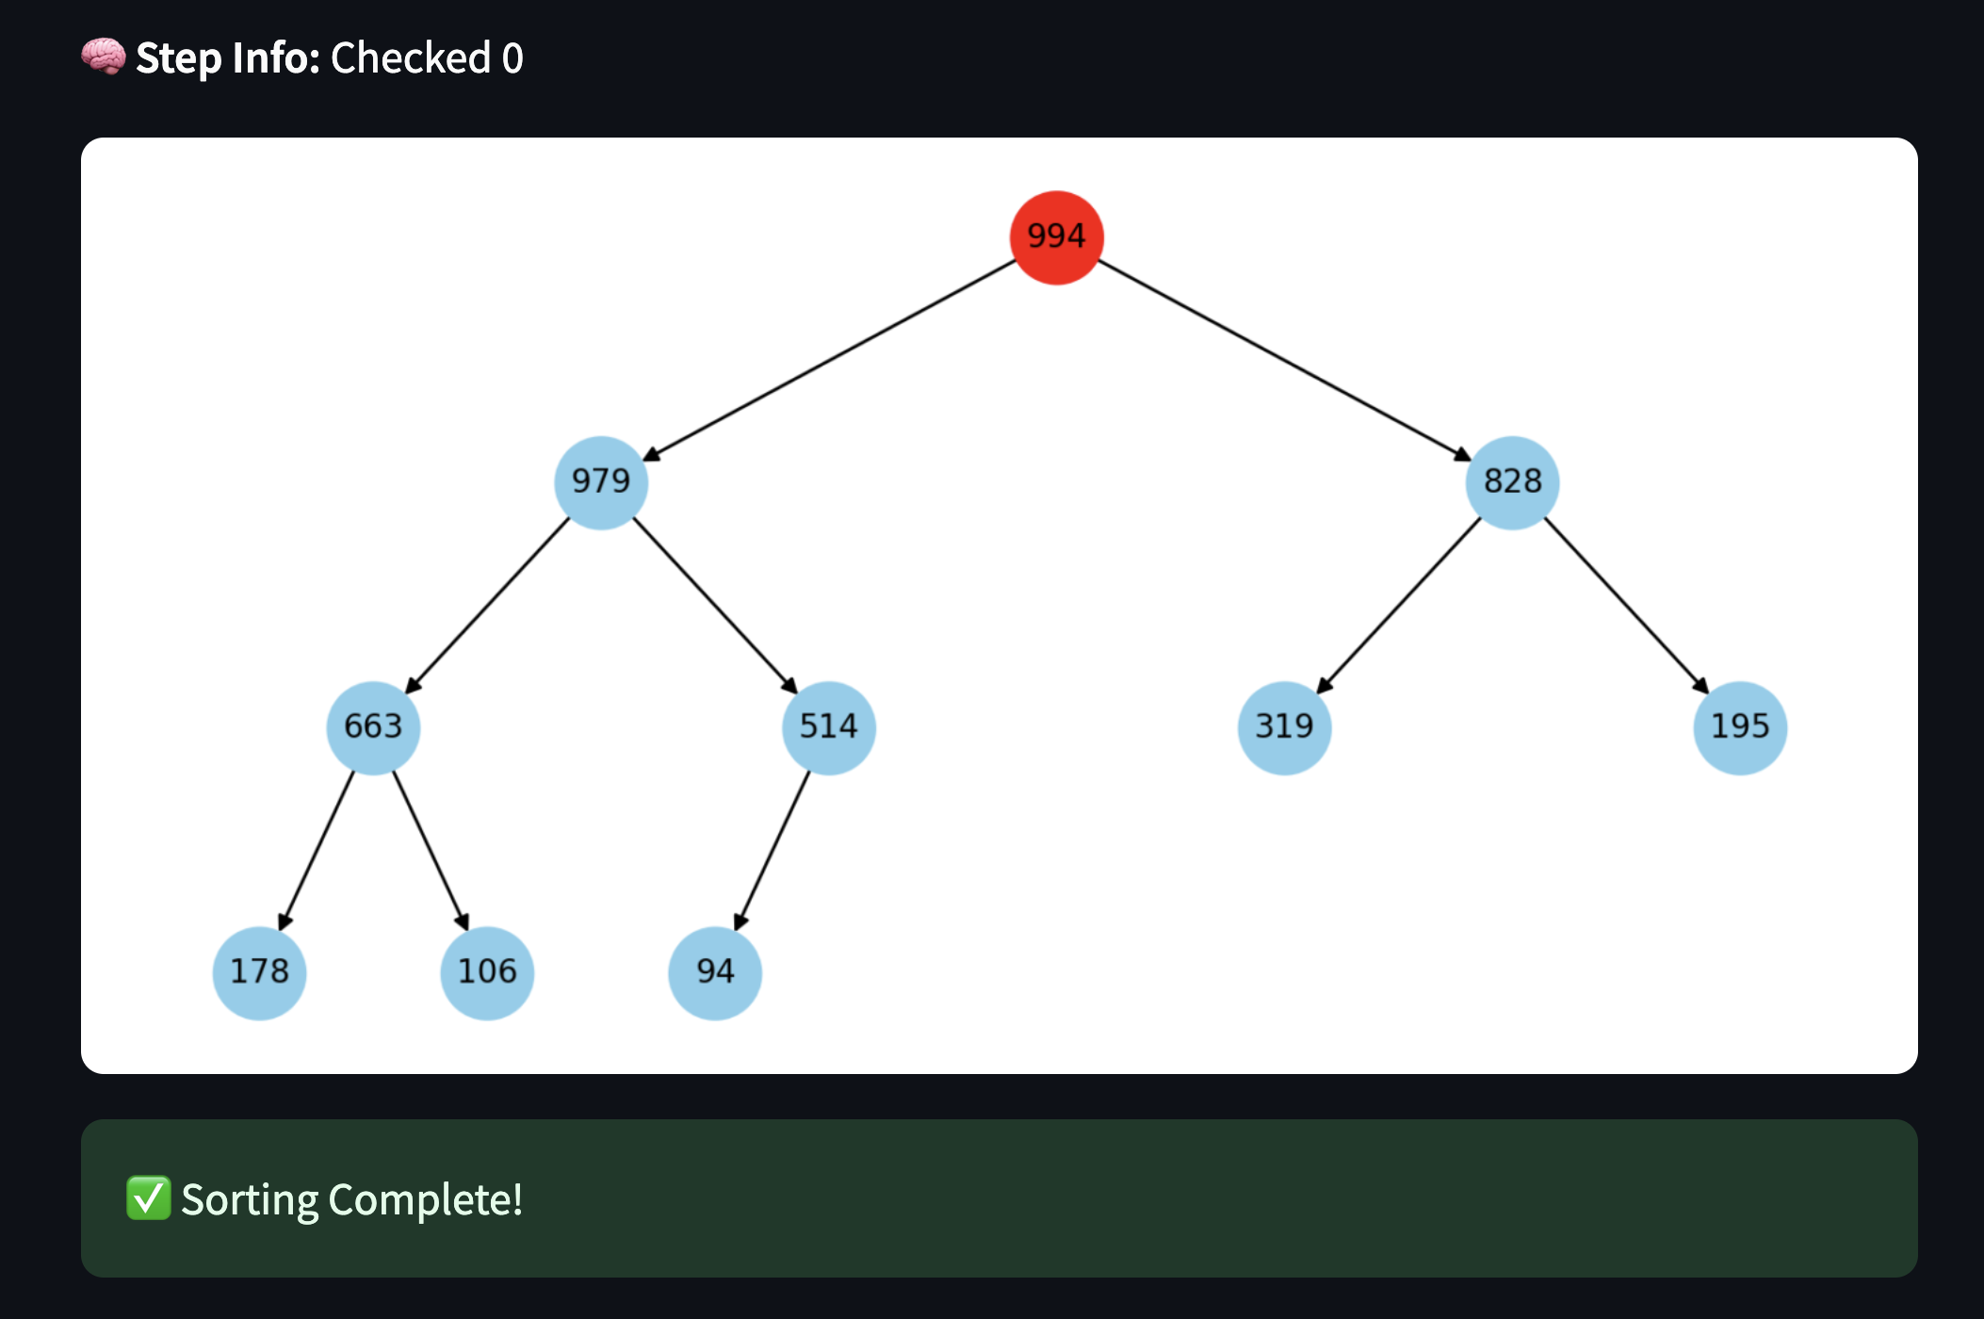
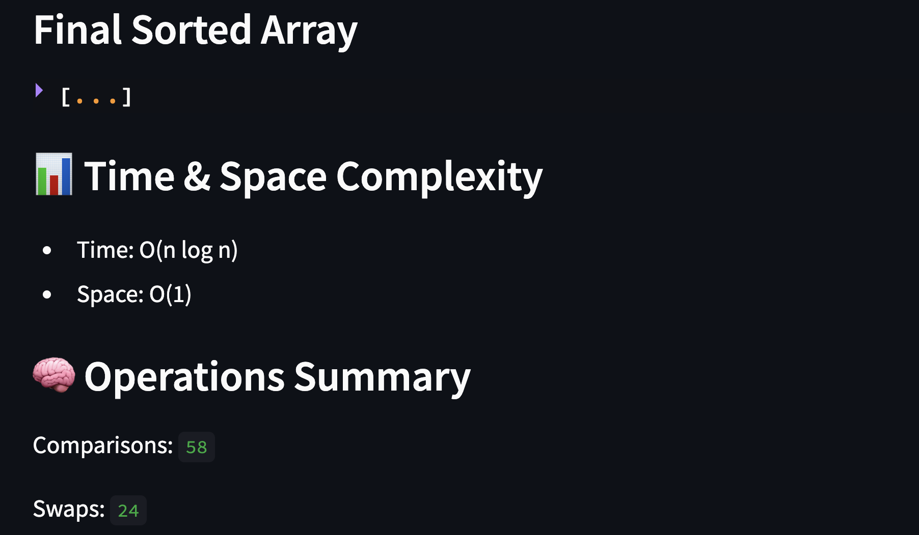
Application –
HEAP SORT VISUALIZATION
Below is a screenshot visualization of the application output.

Slide 5
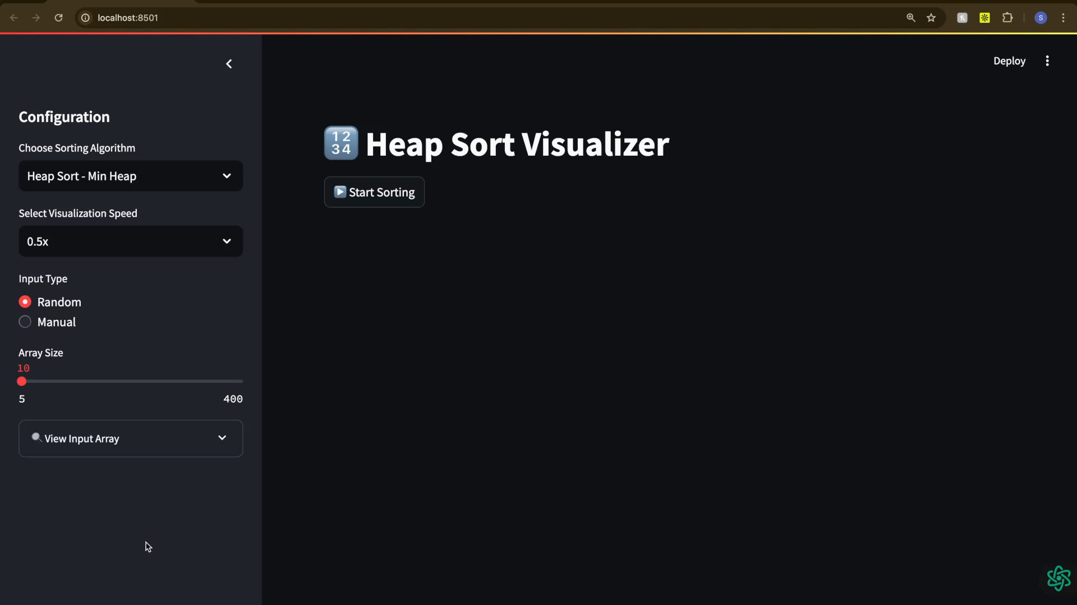
DEMO
HEAP SORT VISUALIZATION
Please click the below video to view the working of the application.

Slide 6
FUTURE SCOPE
HEAP SORT VISUALIZATION
Additional sorting algorithms can be visualized in a similar pattern.
Binary tree visualization can be modified to accommodate a large number of input elements.
Futuristic application for our project will be deploying the application for Ed-Tech space where this application could serve as a learning tool for students/enthusiasts.

Slide 7
Any Questions?

Slide 8
THANK YOU

